Slide 1
Guitar Pedal for Wah Distortion Effect
Presented By :
Ben Schmitz
benjamin.schmitz@mavs.uta.edu
Loc Nguyen
loc.nguyen5@mavs.uta.edu
Pedro Villafranca
pedro.villafranca@mavs.uta.edu

Slide 2
Table of Contents
How Guitars Generate Signals
What is a Wah Pedal?
Requirements and Constraints
Pedal Comparison
Block Diagram
Simulations
Task Delegation
Schedule

Slide 3
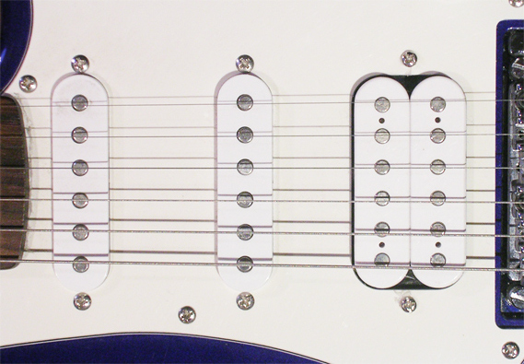
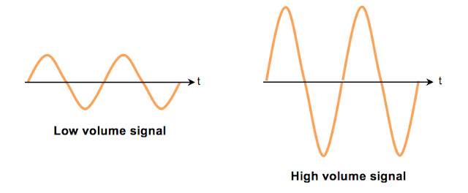
Guitar Signal Generation
Small magnetic coils are placed at the end of the guitar
After strings are plucked, they oscillate over the top of the coils
This creates a moving magnetic field and as a result, current is induced
Plucking the strings harder generates higher amplitude signals (louder)
This signal then gets sent to the output jack on the guitar and fed into the pedal
Notes:
-Bens slides: Guitar and Input Buffer

Slide 4




What is a Wah?
Stomp box- treadle style foot pedal - with potentiometer
Guitar Pedal that will allow you to get the “wah” effect
Wah effect is an onomatopoeia which sounds like how it reads
Popular songs that use the “wah” effect
Notes:
-Tony
Our goal is to distort an analog signal coming from a guitar.
Treadle style foot pedal - rocks back and forth from heel to toe
ALL the way back to turn off the effect and get into bypass mode
Potentiometer - many different ones but ours is used for guitars variable resistor(adjust resistance), two resistors, as you press down R1 increases resistance and R2 decreases vice versa.
Stompbox- foot instructed pedal
https://mynewmicrophone.com/what-are-wah-wah-guitar-effects-pedals-how-do-they-work/
https://mynewmicrophone.com/what-are-wah-wah-guitar-effects-pedals-how-do-they-work/

Slide 5
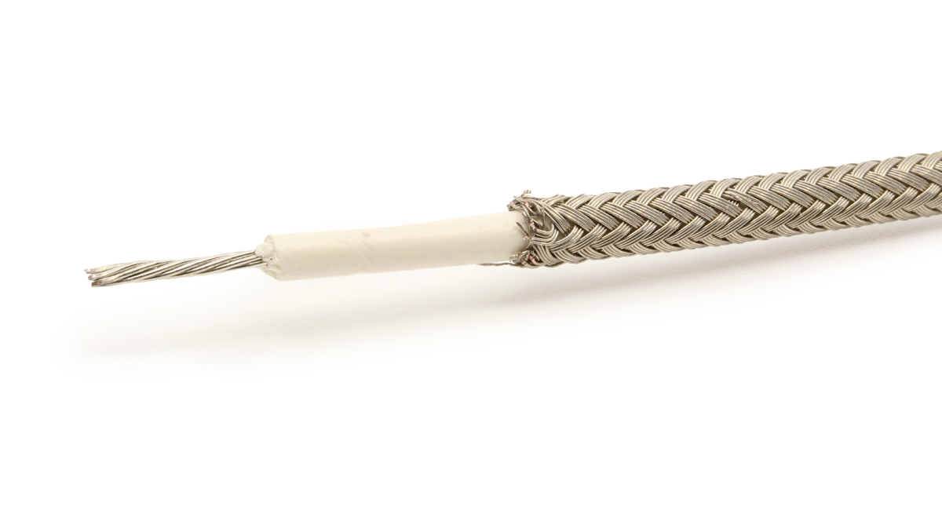
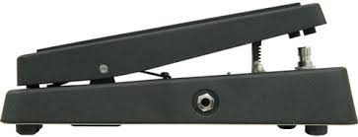

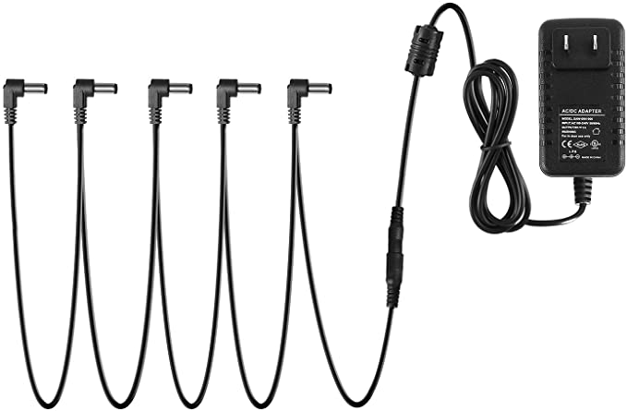
Constraints and Requirements
Constraints
Output jack cable must be stranded (more durable)
Must be pedal operated
Sound Distortion within 280-3.1khz range
Dimensions Match Amazon Housing
7x5x7 Housing
6 ¾” x 4 ½” Board
Requirements
Analog signal distorted by pedal circuit
Has to use ¼” input and output jacks
9 V 310 mAH Battery or Direct Power supply 9 V ⅔ A (daisy chain or direct)
Notes:
-Ben
Needs to be a pedal because it allows for a solid base for the pedal to stand on
280-3.1k Is the frequency range that allows for the funk/soul sound. Anything below 280 becomes muddy, anything above 3.1kHz will sound too harsh
¼” jacks have been used since the 30’s and are extremely simple to build and use and so have became standard for all guitars. Why not optic fiber/usb : Guitars produce analog signals and those use digital signals, youd need an AD converter. Meaning a digital circuit on your guitar.
Height : You dont want your tibialious anterior (front of calf) muscle to be strained during guitar sessions. Also have enough swing room
Direct Power supply would allow your pedal to not die mid guitar session
Daisy Chain means that you can connect multiple to one power supply

Slide 6
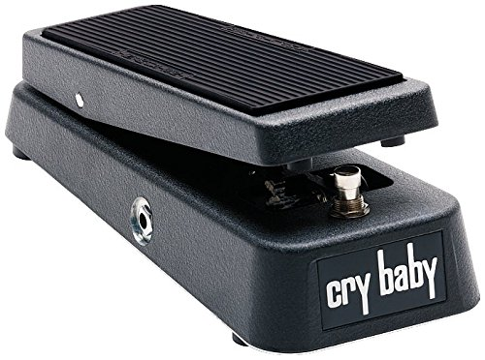
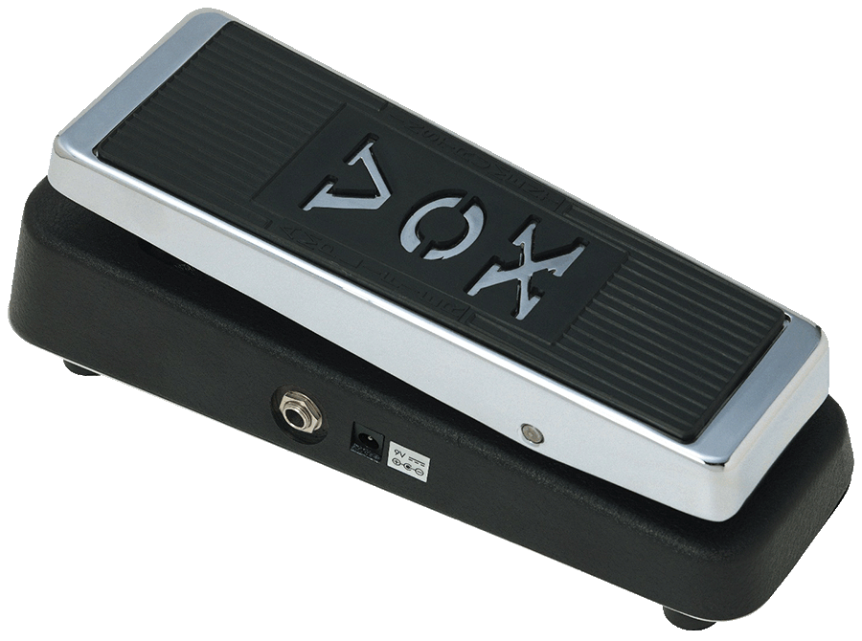
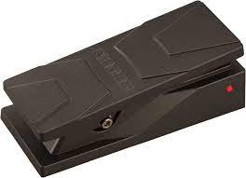
What's been done?
Brand | Size (LxWxH) | True Bypass | Specialization | Appearance | Price | Weight
Crybaby | 10”x4”x2.5” | YES | Used by Jimi, most popular tones |  | $89.99 | 3.7lb
Vox | 9.9”x4”x2.95” | NO | Increased buffers to allow better bypass |  | $119.99 | 2lb
Boss PW3 | 7.56”x3.15”x2.28” | NO | Switch between modes to change pedal effect |  | $137.99 | 1.76lb
True Bypass : When the pedal is off, it acts as a short circuit allowing the guitar signal to pass right through without getting distorted
Notes:
-Ben
True bypass - If the pedals turned off but still plugged in, the sound of the guitar will be the original sound.
Vox model lacks a significant input buffer. This results in a flatter sound, which some people prefer.

Slide 7
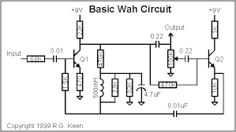
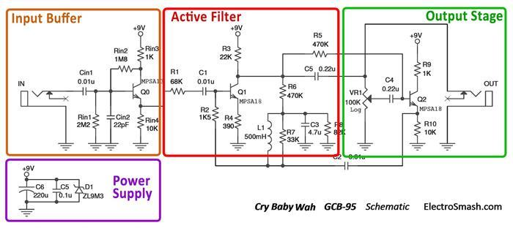
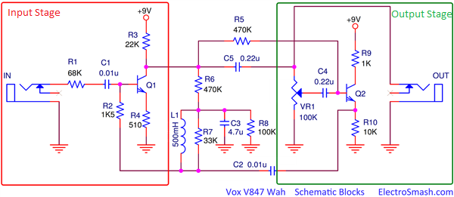
Different Types of Wah Pedals
Basic Wah Pedal Diagram
Cry Baby Pedal Diagram
Vox Circuit Diagram
A basic wah pedal circuit serves two purposes, low-pass filter and high pass filter.
Low frequencies pass through and higher frequencies are blocked when heel is depressed
High frequency are pass when toe end is depressed (reference link here)
One of the special feature in cry baby is the Input buffer. It maintains the original sound from the guitar by buffering it and preventing the signal from losing high frequencies
(More info here)
Here, the input stage does not buffer like the Cry Baby input buffer stage. The sound will be more mellow, which some people prefer to hear
In other words, signal would not be as high input impedance as the Cry Baby’s
More info can be found here
Notes:
-Loc:
- Basic wah pedal - You can see that in the basic wah pedal, it has a circuit system similar to the active filter. What that circuit system is, they call it the common emitter amplifier it also has a feedback network with voltage divider..
Input Buffer - emitter follower
- The components that make up that special feature in Cry Baby are the 2M ohms Rin1 and 1M in the Rin2. The high resistance maintains a high impedance to prevent hi frequency loss.

Slide 8
Block Diagram for Cry Baby Pedal
Wall Power
(120 VAC)
Legend
Note that this block won’t be applicable if we power the pedal with a battery
Power
Signal
Power Supply
(Approx 9 VDC)
Guitar
(100 mV to 1.5 V )
Input Buffer
(Buffers signal, prevents high frequency loss)
Active Filter
(Feedback network, voltage gain is reduced from 19 to 1 dB)
Output Stage
(Emitter follower, Low output impedance)
Output Jack
(680-8.3k Ω)
Guitar output voltage level depends on strum strength and speed, along with amount of pick ups.
Output impedance depends on the VR1 potentiometer level.
Notes:
Introduction, Here is a block diagram of the cry baby model. Each member will be breaking each block apart and explain to you what each of the block does and what it contains.
Guitar sends the analog signal to input buffer. Input buffer uses emitter follower circuit to take in high impedance and convert it to low impedance. Additionally, the input buffer helps maintain a consistent impedance for the rest of the circuit, thus preventing high frequency signal loss.
-Ben gets guitar and input buffer block
-Loc gets active filter and power supply-Tony gets output stage and output jack
Active filter: common emiter amplifier.

Slide 9
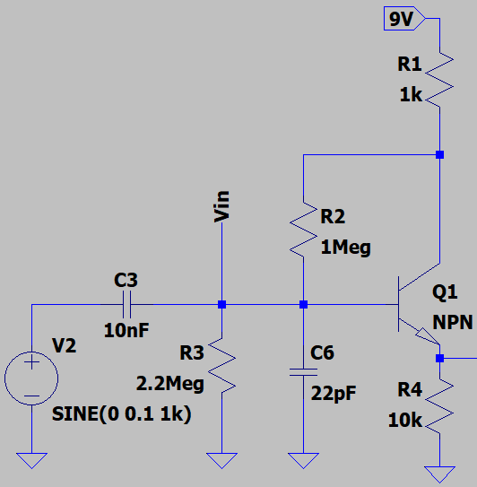
Input Buffer Stage
The job of the input buffer is to create a high input impedance(1M Ohm) and a relatively low output impedance
Doing this prevents signal degradation between other pedals and the amplifier
Preserves the high frequencies in the signal coming from the guitar throughout the circuit
R3 in parallel with R2 and Q1 create the high input impedance of 1M Ohm
Notes:
-Bens slides: Guitar and Input Buffer

Slide 10
Input Buffer Stage - Analysis
The output of the first stage is at the emitter of transistor Q1
This output node is connected to the rest of the pedal circuit
Later on in the design process, we’ll want to know what the voltage is at this node for troubleshooting purposes
If Q1 has a series resistance of 10K, the current through the emitter of Q1 times this resistance will yield a voltage
This node represents the output of the Input Buffer Stage
Notes:
-Bens slides: Guitar and Input Buffer

Slide 11
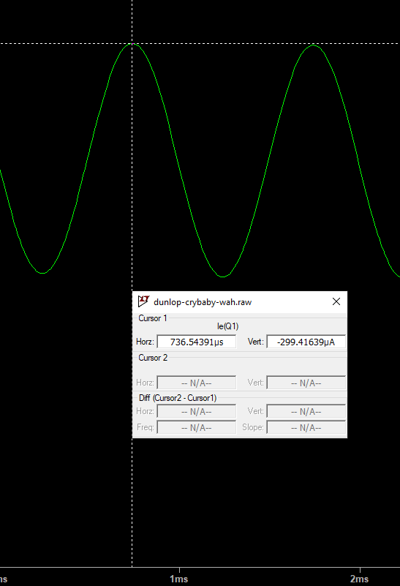
Input Buffer Stage - Simulation
Here we can see that the measured current through the emitter of Q1 has a peak value of 299.4 uA
Using Ohms law: V=IR
V = (299.4 uA)(10K Ω)
V= 2.994 Volts
We can now use this information to troubleshoot our breadboard prototypes
Notes:
-Ben

Slide 12
Input Buffer Parts List
4 Resistors
1K Ω
10K Ω
1M Ω
2.2M Ω
2 Capacitors
10 nF
22 pF
1 NPN Transistor
Notes:
-Bens slides: Guitar and Input Buffer

Slide 13
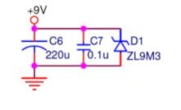
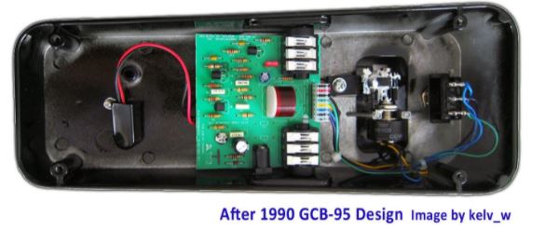
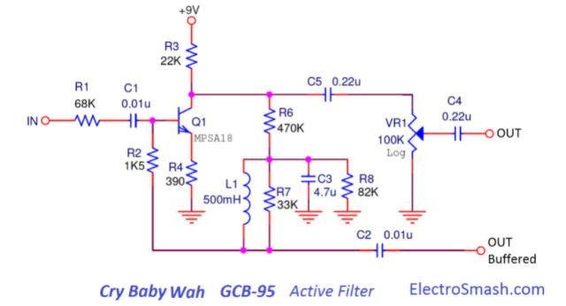
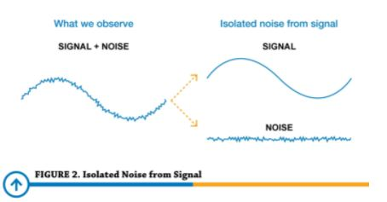
Power Supply and Active Filter
Power Supply
Powers ~ 9.0-9.1VDC to the three circuits: Input Buffer, Active filter, and output stage
The capacitor C6 and C7 are there to filter out noise
Active Filter
Common-Emitter Amplifier with feedback network
Negative feedback in the amplifier will improve and stabilized the frequency response of the signal
If frequency response is not stable, you will not hear certain sounds or will hear a weird ugly sound
Power Supply Filter
Battery Connector
Notes:
-Loc Slides: Active filter and Power Supply
Feedback network goes from collector to base of Q1. When negative feedback is applied, overall voltage gain and input impedance is reduced.
When pedal is pressed, voltage gain is reduced and thus from 19dB to 1dB, the sound level is reduced.
Freq Response is the range of the noise that guitar is created. So if the sound changes to a weird ugly noise or sounds that you could not hear but feel in your ear drums, then you know the freq response is off. The means the measurement of the noise is out of a stable gains.

Slide 14
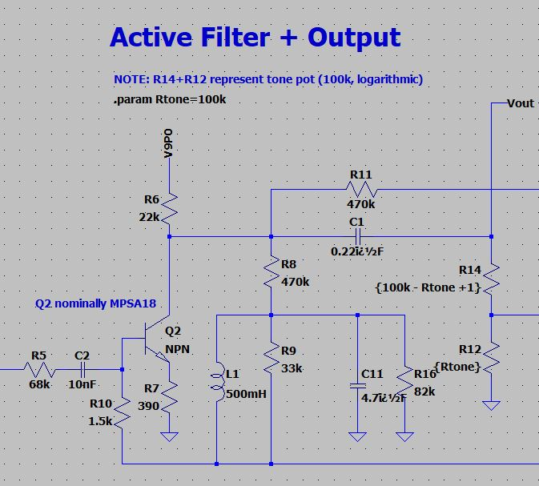
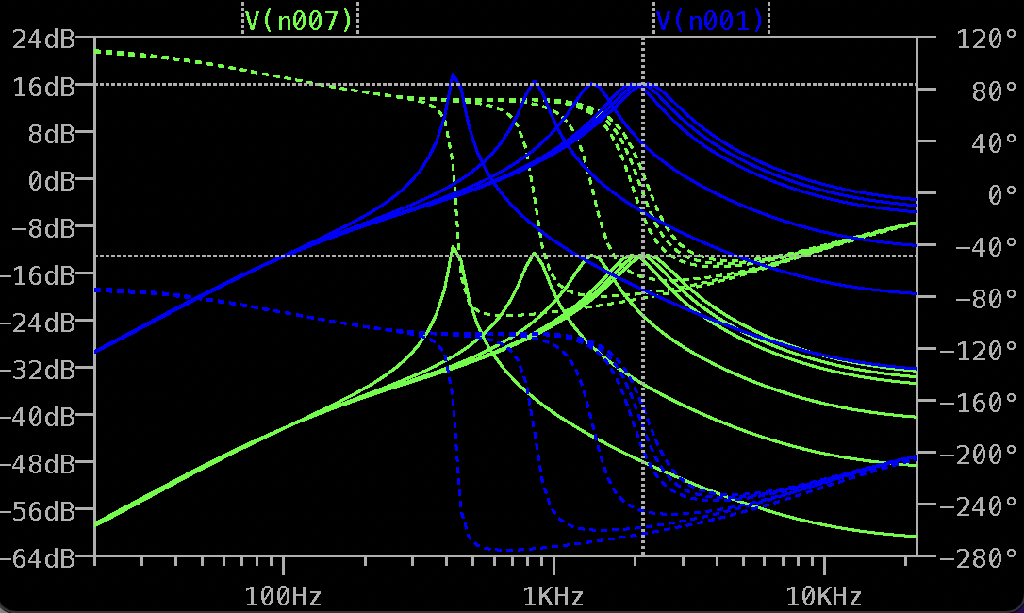
Active Filter Circuit
Expected input V(n007)
Voltage: ~778mV
Frequency: ~2.02KHz
Tone: ~ (-13.16 dB)
Expected Output V(n001)
Voltage:~5.81V
Frequency: ~ 2.02KHz
Tone: ~ 15.88 dB
Output
Input
Notes:
Loc: simulations. Talk about voltage divider and how much voltage will drop across R8.

Slide 15
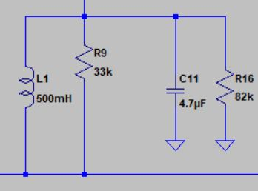
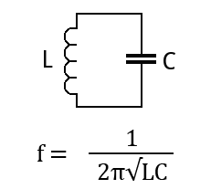
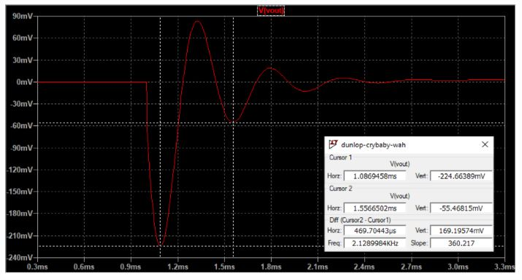
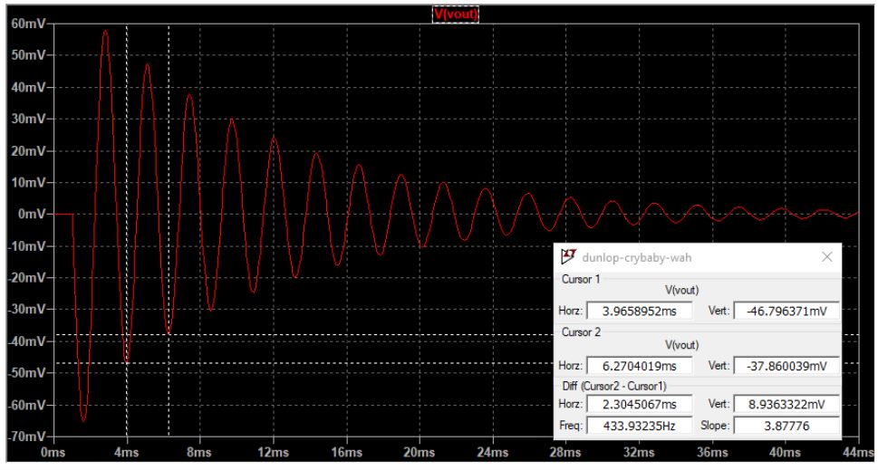
LC tank and how it affects the output
Made up of L1 and C11 in the Active Filter Circuit. It’s purpose is to accentuates different frequency.
R tone( varies by how much pedal is depressed). It controls the amount of current and the amount of frequency going into LC tank.
R tone = 100k ohm Vs R tone = 100 Ohms
When R tone is at 100k Ohms, current to the LC tank will be low and we will get a low frequency output of ~430Hz.
When R tone is at 100 Ohms, current is increased and we will get a higher frequency of ~2.1k Hz.
LC circuit is the main reason why there is a band frequency from 430 to 2.1k Hz.
R tone = 100k Ohms
Notes:
Loc: simulations. Talk about voltage divider and how much voltage will drop across R8.

Slide 16
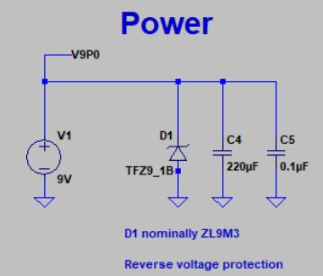
Power Supply Circuit
Output
Power is 9.0 to 9.1VDC
Expected Output: Approximately 9.0-9.1VDC
Zener Diode provides reverse voltage protection by limiting voltage to be no more than 9.1VDC by stopping the current in the Zener Diode to flow.
The power source, Zener diodes, C4, and C5 are all in parallel. Thus, 9VDC voltage drops across them.
Power Supply is powering all three circuits: input buffer, active filter, and output
Notes:
Loc: simulations.

Slide 17
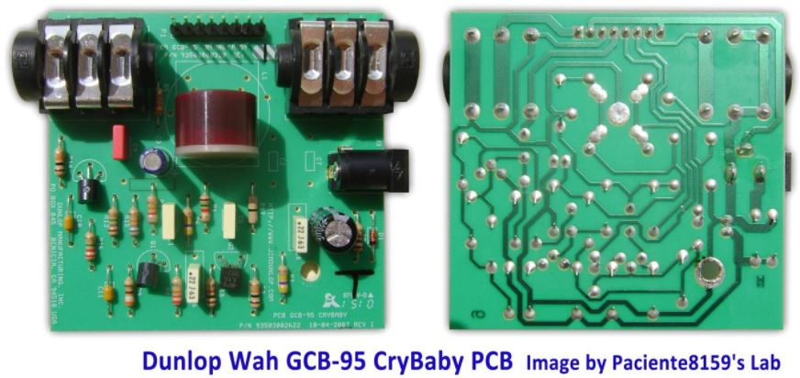
Parts List for Active Filter and Power Supply
Active Filter Stage
22k Ohms Resistor (1)
NPN transistor (1)
390 Ohms Resistor (1)
1.5k Ohms Resistor (1)
68k Ohms Resistor (1)
33k Ohms Resistor (1)
470k Resistor (2)
100-100k Ohms Potentiometer (1)
82k Ohms resistor (1)
10nF Capacitor (1)
4.7uF Capacitor (1)
0.22nF capacitor (1)
500mH Inductor (1)
NPN transistor (1)
Power Supply
9 VDC Battery (1)
Zener Diode (8.51-9.01VDC) #TFZ9_1B (1)
220uF Capacitor (1)
0.1uF Capacitor (1)

Slide 18
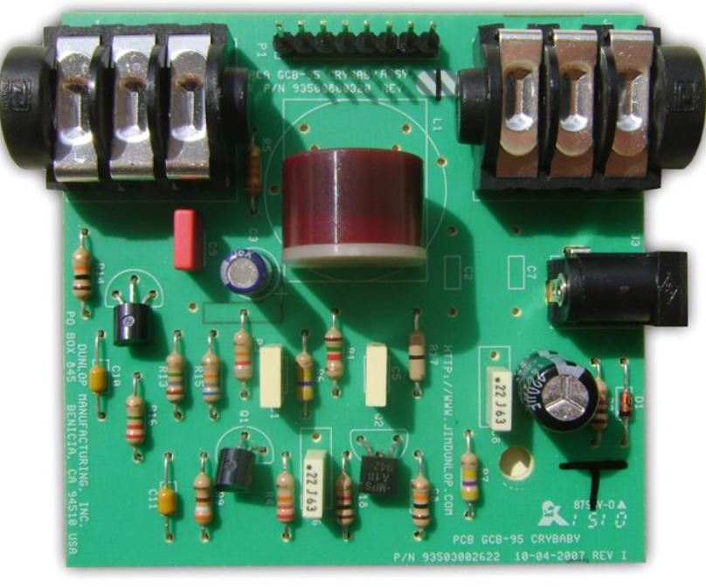
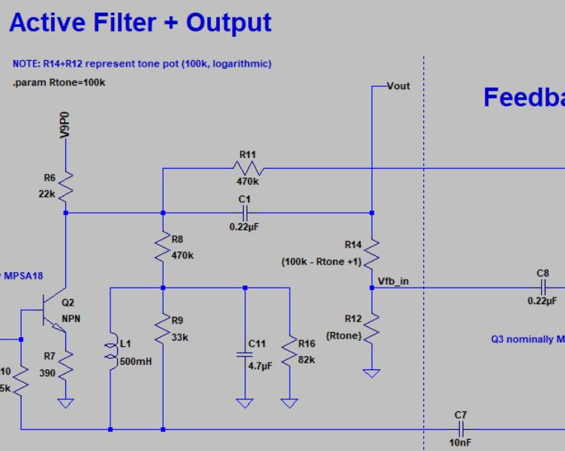
Film Capacitors and their benefits
Film Capacitor. (C1) because they tend to be more linear than ceramics.
Ceramics often reduce It’s rating up to 50%. This can cause a great amount of distortion.
Film capacitor are more linear so there will be less distortion in the signal.
These characteristics are important when it comes to low capacitance. (.22uF)
C1
C1

Slide 19
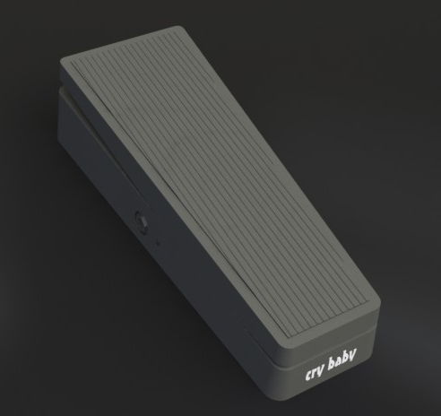
AutoCAD design for Cry Baby
Here is a link of an already made CAD design for cry baby pedal.
https://grabcad.com/library/my-guitar-effects-pedalboard-1/details?folder_id=939896
True Bypass indicator by adding an LED in between the step and the base. It should be where the button is.
Notes:
Loc: Using CAD to design the pedal.

Slide 20
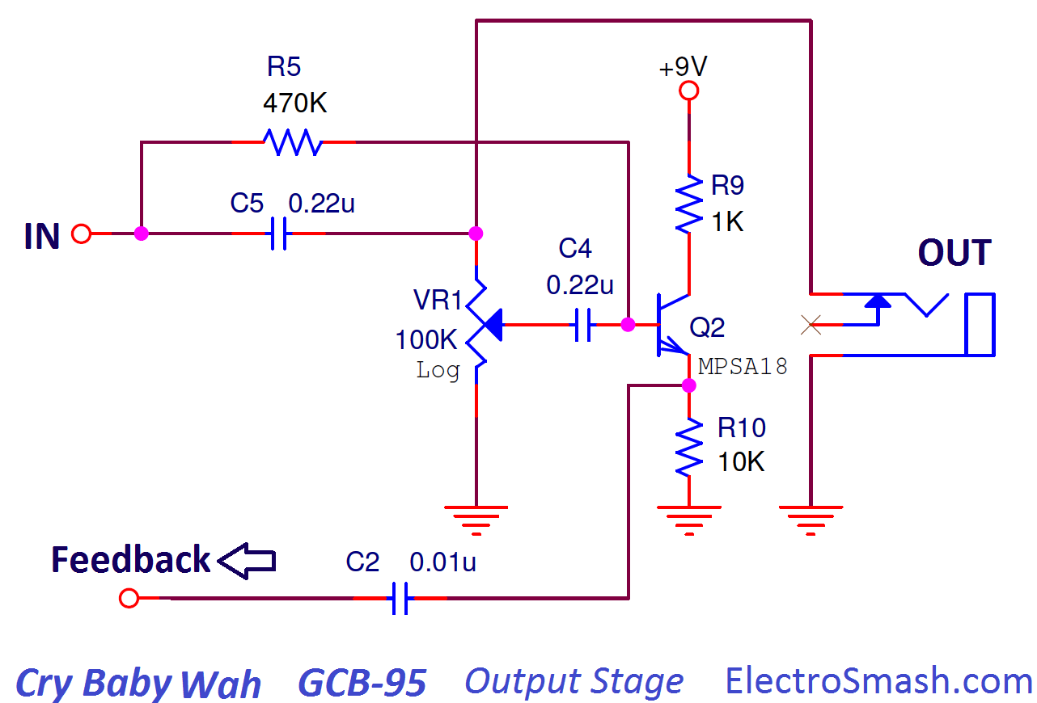
Output Stage and Output Jack
Similar function as the input buffer
Emitter Follower circuit - takes high impedance and converts to Low output impedance to amplifier ( or next pedal)
Connects to output jack and buffer transistor(isolates one circuit from another, and provides amplification)
Sends feedback and restarts process to input stage
Gives a more clear noise by changing input impedance
OUTPUT JACK
Connected to Active Filter
Sends back signal
Notes:
-Tony slides: Output stage and output jack
EM- prevents high frequencies,
High impedance allowed to preserves original guitar tone

Slide 21
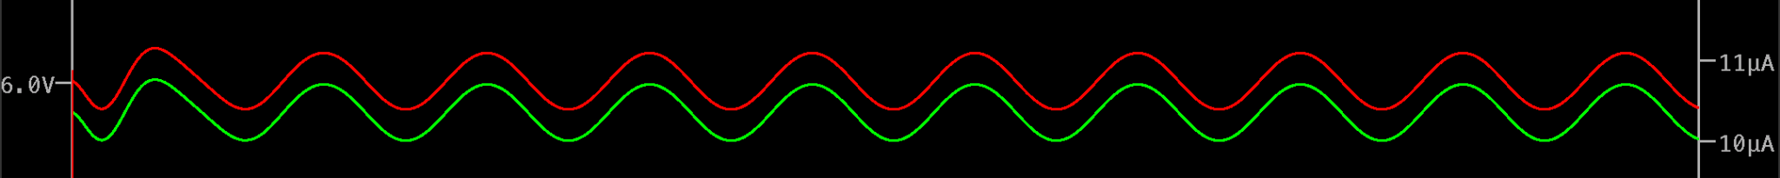
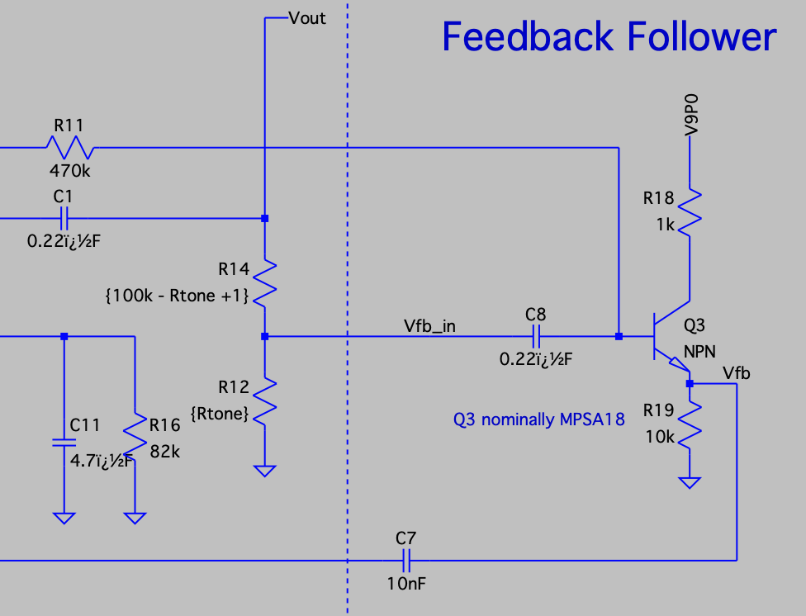
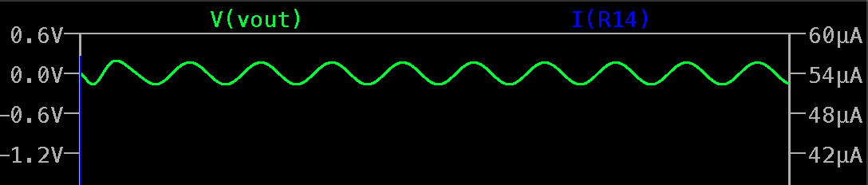
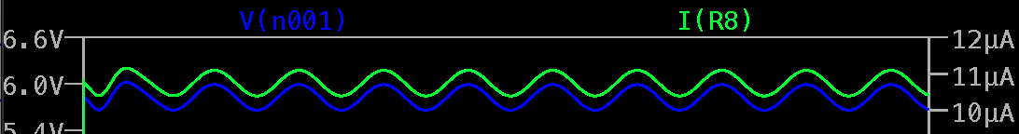
Output Stage and Output Jack- Simulation
INPUT:
Measured : 6.1 V , 11.1 μA
Derived : 552 kΩ (impedance)
Output
Measured : .09 V, 55μA
Derived : 1.6kΩ
Huge difference in the Impedance entering and exiting this section of the circuit
As pedal goes up and down we should see a difference in the voltage
As the variable resistor changes, you should see a sweep on the output
Feedback :
Measured : 0.78 V, .97 μA
Derived : 803 kΩ

Slide 22
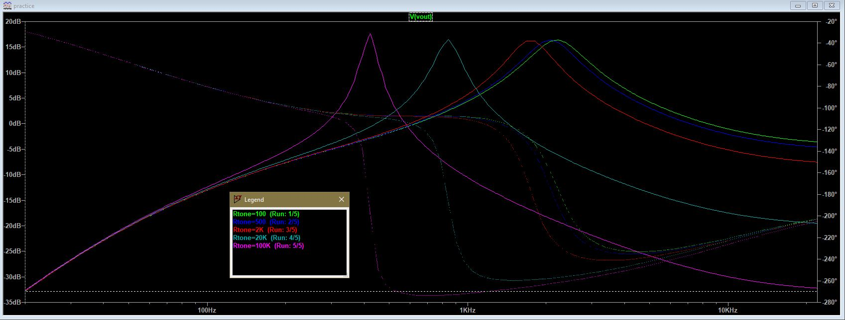
Output Stage and Output Jack- Variable Resistor
Fully Depressed : Pink
Level 1 : Light Blue
Level 2 : Red
Level 3 : Blue
Fully Pressed : Green
The band signal here is within 430 Hz to 2k Hz.

Slide 23
Output Stage and Output Jack- Parts List B.B
1 Variable Resistor ( Potentiometer )
100k
4 Resistors
470K
82k
10k - DC return for emitter follower
1k - reduces oscillation of signal
3 Capacitors - reduce noise by picking up current
.22 uF
4.7uF
.22uF
1 Transistor
45 V 200 mA
1 ¼” Output Jack
Connect Pedal to Amp
Threaded Cable, Less chance of breaking
Copper
$8.45 Guitar Center

Slide 24
Implementing LED indication for True Bypass
https://www.youtube.com/watch?v=kqyFsuC9fk4&ab_channel=CSGuitars
Solder wire to an LED
LED will be place right between the step and the pedal through a drilled hole.
Notes:
By Loc

Slide 25
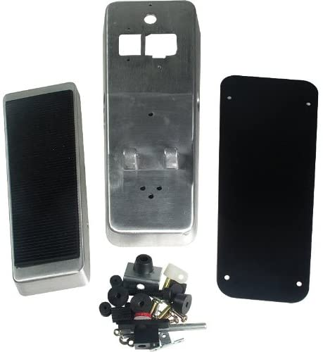
Enclosure
Amazon - $47.64
Includes : Bolts,nuts, foot rest, floor pad
2.5 lb
7” x 5” x7”

Slide 26
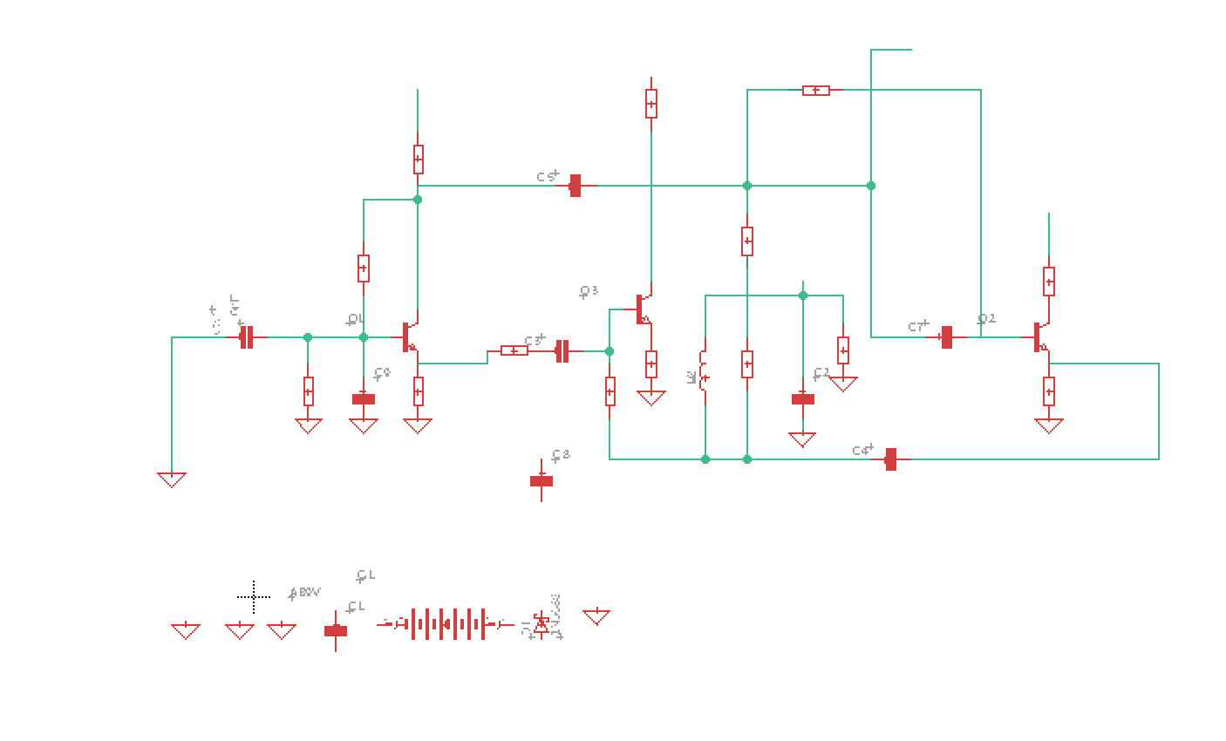
Eagle PCB

Slide 27
Task Delegation
Task Name | Ben | Loc | Tony
Research & Brainstorm | 33% | 33% | 33%
Circuit Simulation | 50% | 25% | 25%
Breadboarding Prototype | 25% | 25% | 50%
Revise and Improve | 25% | 50% | 25%
Integrate onto PCB | 25% | 50% | 25%
Housing | 25% | 25% | 50%
Presentation | 33% | 33% | 33%
Notes:
-Tony slides: Output stage and output jack
EM- prevents high frequencies,
High impedance allowed to preserves original guitar tone

Slide 28
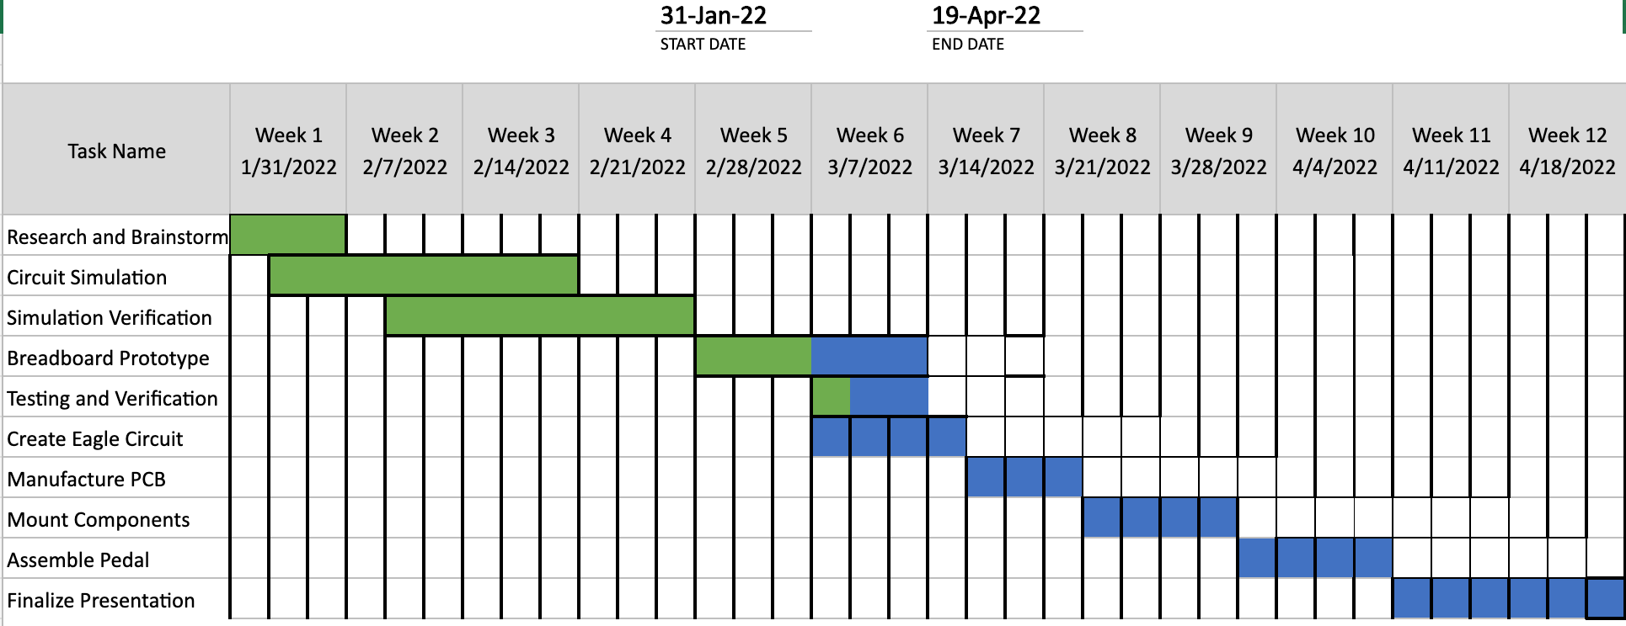
Schedule Overview
Notes:
-Ben

Slide 29
END
Questions?

